Slide 1
COMP 206 – Introduction to Software Systems
Lecture 4 – C Basics Continued
January 18th, 2018

Slide 2
Exercise: A programming challenge
Could you do this in the language you know?
Try to translate each part into C
Ask if you get stuck
Using what we saw so far, can you:
Start with the array shown
Write code to sort the array in increasing order
Output the sorted list on the terminal
Helper: linear sort specification
For each position in the array, pos
Let curr be the current value at pos
Find the position of the minimal element from pos to the end: min_val, min_pos
Swap the values of pos and min_pos
int array[4];
array[0] = 1;
array[1] = 3;
array[2] = 4;
array[3] = 2;
array
1
3
4
2

Slide 3
Sorting
For each position in the array, pos
Let curr be the current value at pos
Find the position of the minimal element from pos to the end: min_val, min_pos
Swap the values of pos and min_pos
Intuition:
1
3
4
2
search
pos
min_pos

Slide 4
Sorting
For each position in the array, pos
Let curr be the current value at pos
Find the position of the minimal element from pos to the end: min_val, min_pos
Swap the values of pos and min_pos
Intuition:
Do not swap
1
3
4
2
pos
min_pos

Slide 5
Sorting
For each position in the array, pos
Let curr be the current value at pos
Find the position of the minimal element from pos to the end: min_val, min_pos
Swap the values of pos and min_pos
Intuition:
1
3
4
2
search
pos
min_pos

Slide 6
Sorting
For each position in the array, pos
Let curr be the current value at pos
Find the position of the minimal element from pos to the end: min_val, min_pos
Swap the values of pos and min_pos
Intuition:
swap
1
3
4
2
pos
min_pos

Slide 7
Sorting
For each position in the array, pos
Let curr be the current value at pos
Find the position of the minimal element from pos to the end: min_val, min_pos
Swap the values of pos and min_pos
Intuition:
swapped
1
2
4
3
pos
min_pos

Slide 8
Sorting
For each position in the array, pos
Let curr be the current value at pos
Find the position of the minimal element from pos to the end: min_val, min_pos
Swap the values of pos and min_pos
Intuition:
1
2
4
3
search
pos
min_pos

Slide 9
Sorting
For each position in the array, pos
Let curr be the current value at pos
Find the position of the minimal element from pos to the end: min_val, min_pos
Swap the values of pos and min_pos
Intuition:
swap
1
2
4
3
pos
min_pos

Slide 10
Sorting
For each position in the array, pos
Let curr be the current value at pos
Find the position of the minimal element from pos to the end: min_val, min_pos
Swap the values of pos and min_pos
Intuition:
swapped
1
2
3
4
pos
min_pos

Slide 11
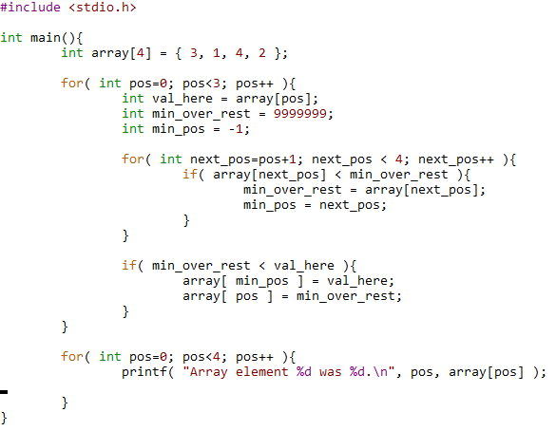
Dave’s Solution in C
Setup the array
One for loop over the position that should next contain the minimum element
Another loop to find the min
An if to check about swapping
Print at the end

Slide 12
Dave’s Solution in C
Setup the array
One for loop over the position that should next contain the minimum element
Another loop to find the min
An if to check about swapping
Print at the end

Slide 13
Dave’s Solution in C
Setup the array
One for loop over the position that should next contain the minimum element
Another loop to find the min
An if to check about swapping
Print at the end

Slide 14
Dave’s Solution in C
Setup the array
One for loop over the position that should next contain the minimum element
Another loop to find the min
An if to check about swapping
Print at the end

Slide 15
Dave’s Solution in C
Setup the array
One for loop over the position that should next contain the minimum element
Another loop to find the min
An if to check about swapping
Print at the end

Slide 16
A bit more “programmatic” version
In 206, we hate to hard-code
I wrote the array size, its contents, and a number of constant sizes throughout my simple solution
What about taking any number of numbers from the user as command-line arguments and sorting that list?

Slide 17
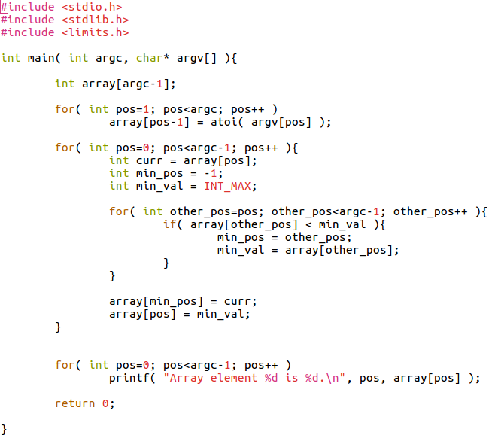
Remember, argc gives you the number of arguments in variable form

Slide 18
atoi() converts a string into the number it represents.
Returns 0 if there was a failure. Good to check this, but we don’t here.

Slide 19
INT_MAX is better than using 999999. It’s guaranteed to hold the largest int value.

Slide 20



First System Element: Data, data, data

Slide 21
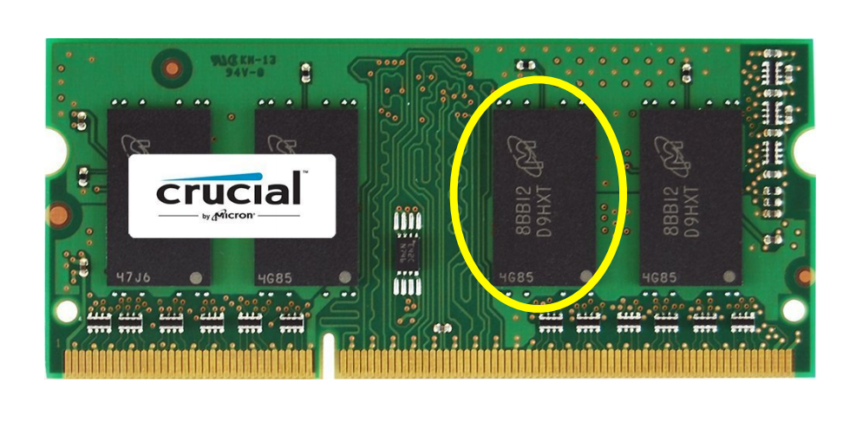
All data is binary (consists of 1’s and 0’s)

Slide 22
Do you know how to count in binary?
0, 1, 10, 11, 100, 101, 110, 111, 1000, 1001, 1010, 1011, 1100, 1101, 1110, 1111, 10000
The equivalent of 0, 1, 2, 3, 4, 5, 6, 7, 8, 9, 10, 11, 12, 13, 14, 15, 16
Find the decimal value of a binary number with the following formula:
Sum of 2^{i} for every “1”, where i is the position in the number, with 0 on right
E.g., 1101 = 2⁰ + 2² + 2³ = 1 + 4 + 8 = 13
Find the binary value of a decimal number with the following formula:
While decimal_val not zero:
Find the largest power of 2 that is less than or equal and add a “1” in the binary number in position i, where i is the position in the number, with 0 on right
decimal_val -= 2^{i}
48 gives 32=2⁵, leaving 16, gives 16=2⁴, leaving 0. So 48=110000

Slide 23
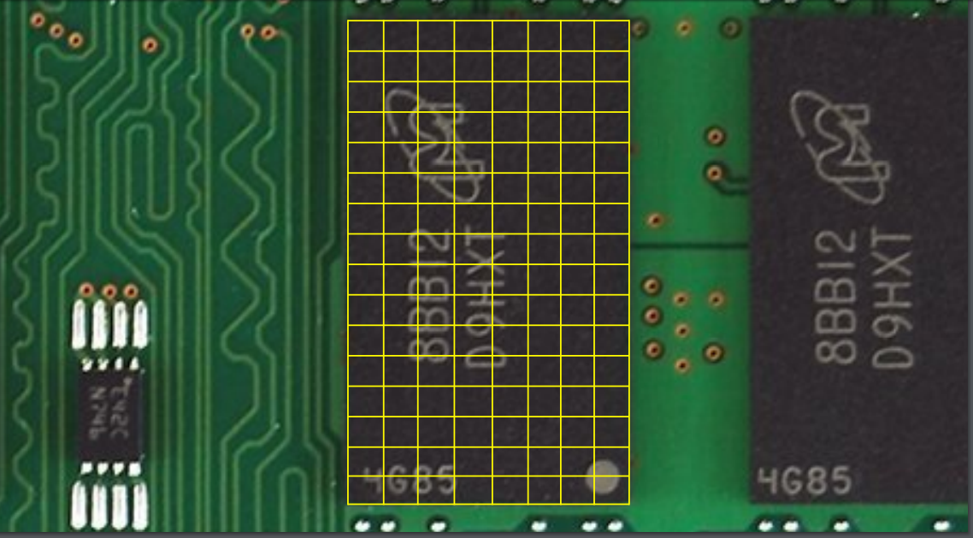
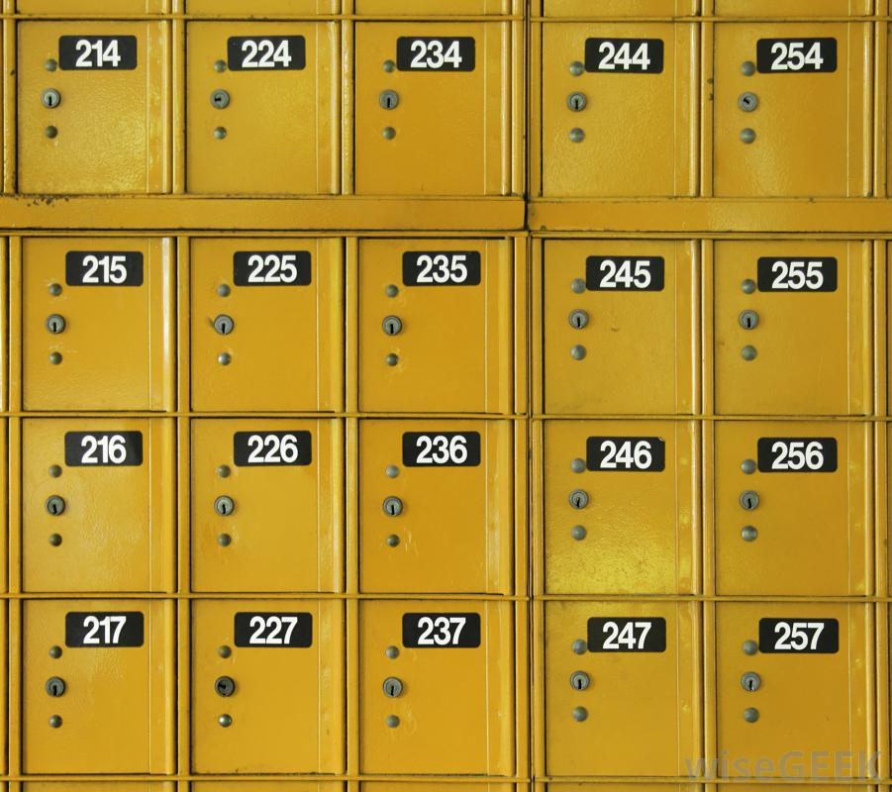
Organized using addresses

Slide 24
What’s in memory: we will understand all of this by the end of this term
The kernel process
The shell process
Your program’s process
The program’s machine code
Program variables
Required libraries
Book-keeping info
For today: we start with the data in a C program

Slide 25
The memory for our variables
Convenient not to think about it? Yes.
Allowed not to think about it in 206? No!
The Operating System and our systems programs must work with the computer’s memory, and C variables are our first way to do this.
Each variable takes space (how much?)
Variables utilizes their memory differently depending on their type (how for each type?)
These are our next topics to study.

Slide 26
How much space does a variable take?
Description | Type | Bits | Range
Integer | short int long | 16 32 64 | +/-32 thousand +/-2.1 billion +- 9.2 x 10¹⁸
Floating point | float double long double | 32 64 128 | +/- 10³⁸ +/- 10³⁰⁸ +/- 10⁴⁹³²
Character | char unsigned char | 8 | -127 to 128 0 to 255
Pointer | char* int* (etc) | 64 | 0 to 1.8 x 10¹⁹

Slide 27
What if we try to store something larger?
short int i=0;
while(1){
printf( “i is %d.\n”, i );
i++;
}

Slide 28
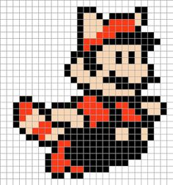
The type matters for real data
Match between the meaning of the underlying data and the available tools and data types from C
Example: 16-bit color image made to be small to work on old game consoles:
Red takes 4 bits
Green takes 4 bits
Blue takes 4 bits
Transparency takes 4 bits
Choices: 2 chars, 1 short, 4 chars, 1 int, etc

Slide 29
Arrays and Memory
Arrays take multiple “slots”, each of the underlying type
E.g. float array[2];
They are guaranteed to be stored in order
The number as you specify on array creation and does not change

Slide 30
C Strings
Arrays of characters
E.g. char name[100] = “David”;
Each element is a character stored using the ASCII table
A mapping between our printable letters and the 0’s and 1’s in memory
Must be “null terminated” with the special ‘\0’ NULL value, with integer representation 0
This allows things like printf to output just the data you want
Let’s think about that

Slide 31
Strings in memory
H
e
l
l
o
\0

Slide 32
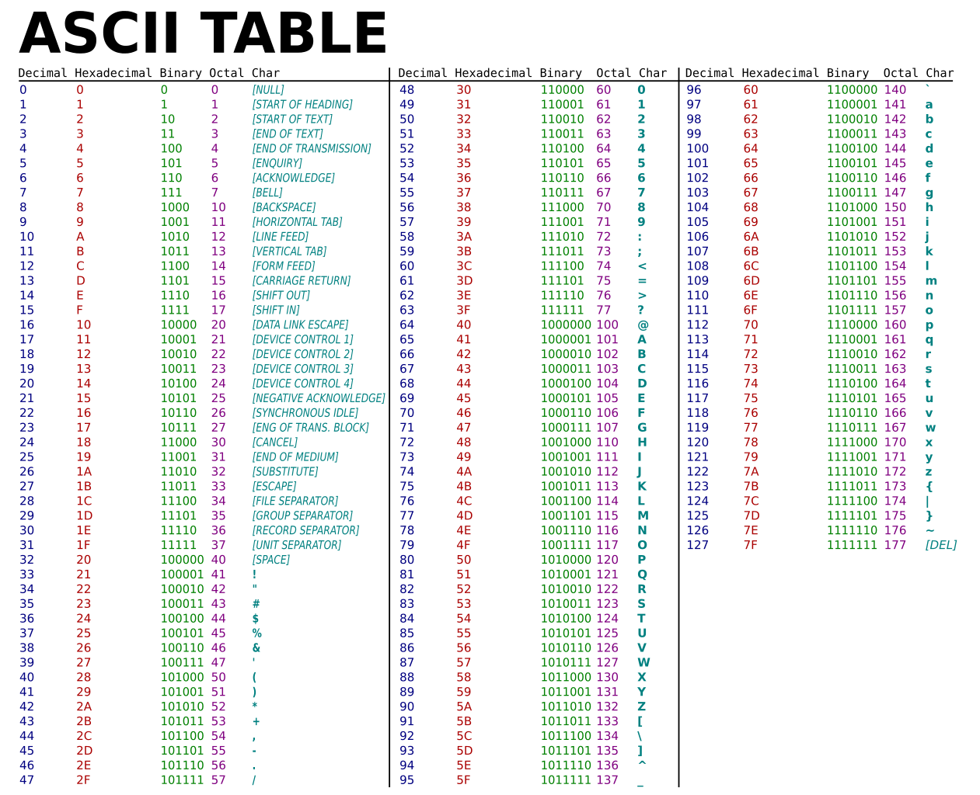
Memory is binary
Char type is really an 8-bit integer
The mapping to text characters is defined by another standard!

Slide 33
Exercises
Write a C program to reverse the characters in its first argument and output to terminal
Re-write our sort program to sort text words instead of numbers
Write a program that tells you the number of characters in a word, the number of words on a line, or the number of lines in a file (requires reading ahead)
Continues to be a good idea: K&R book, Chapters 1-4 & 7

